Slide 1


Preparing Time Series Data in Python: Examples
Wake Forest
School of Business
_______
Forecasting

Slide 2
Accumulating and Indexing

Slide 3
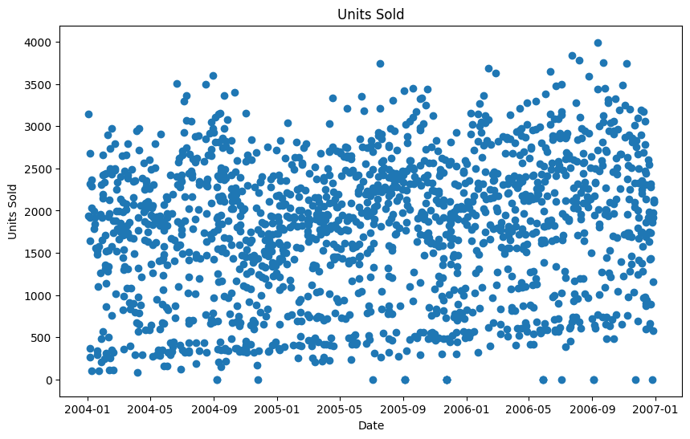
Raw Point of Sale Data

Slide 4
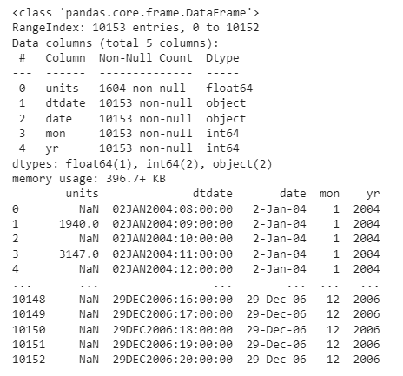
Accumulating and Indexing a Time Series

Slide 5
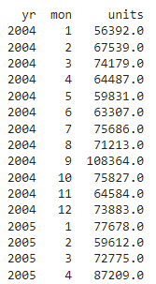
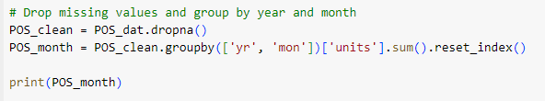
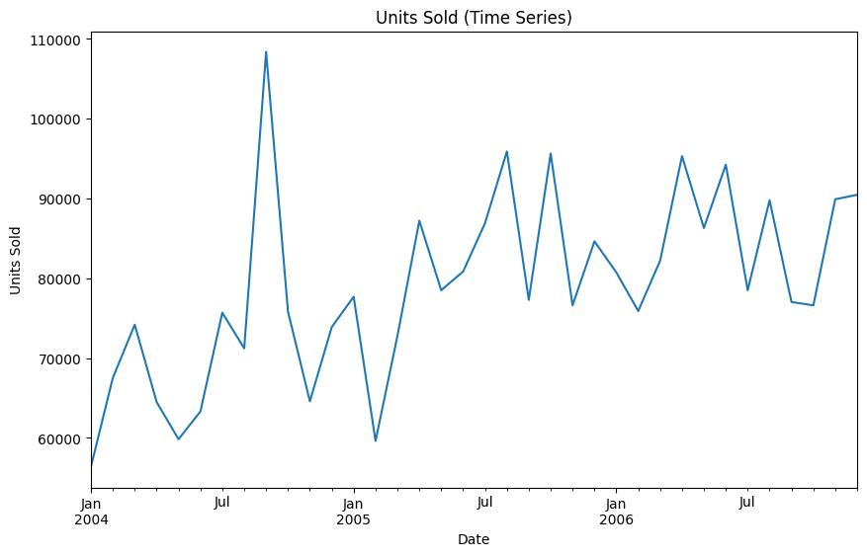
Accumulating and Indexing a Time Series

Slide 6
Handling Missing Values

Slide 7
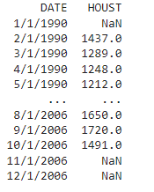
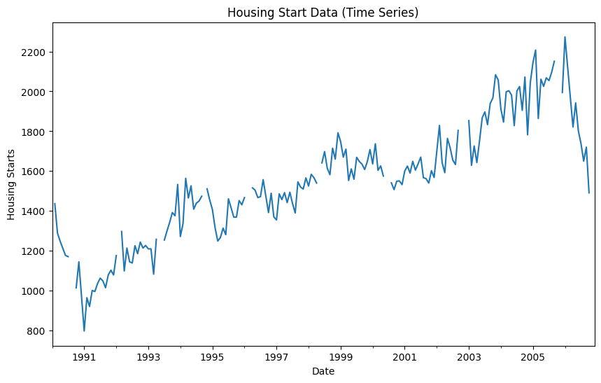
Housing Starts Data

Slide 8
Impute Missing Values Using fillna or interpolate
You can impute missing values using fillna
mean – imputes missing values using the mean
locf – imputes using the last observation carried forward
nocb – imputes using the next observation carried backwards
Or by using interpolate which uses a linear interpolation based on the previous and next values in the series

Slide 9
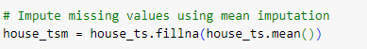
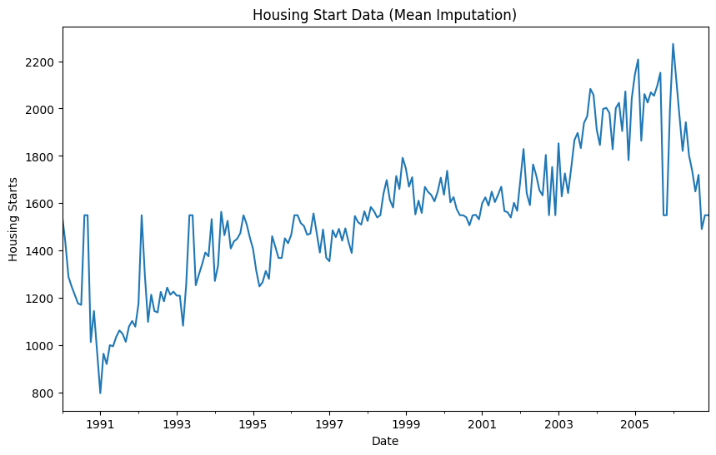
Mean imputation

Slide 10
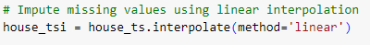
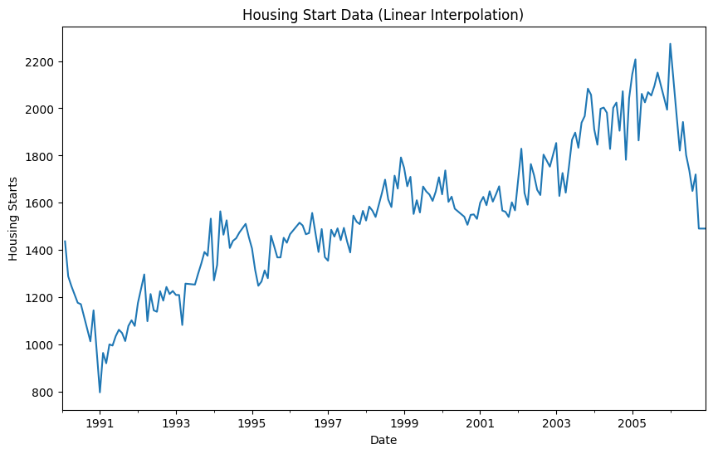
Interpolation

